Slide 1
Adventure Awaits
(Tourism Recommendation System)
We Suggest you the best places to visit
DONE BY:
Jeevetha R IV CSE
Kavya S IV CSE
Nancy Roselin T IV CSE
GUIDED BY:
Mr. N.Umakanth M.E, (Ph. D)
Assistant Professor (Sr.Grade),
Dept. of Computer Science and Engg.
Mepco Schlenk Engg College (Autonomous)
Department of CSE

Slide 2
PROBLEM STATEMENT
To develop a website that recommends customized touring locations for users according to the city information given by them.
Department of CSE

Slide 3
OBJECTIVES
To design a system that recommends tour places to the users.
A personal tourism recommender system is considered as the effective way for tourist to tourist attractions search.
The recommender system compares the collected data to similar and dissimilar data collected from others and calculates a list of recommended attractions for the tourist.
Department of CSE

Slide 4
SCOPE
This system is applicable for the locations predominantly in the southern part of India.
It also includes some of the famous locations in the north.
Department of CSE

Slide 5
PROPOSED SYSTEM
Enables the end users to select the city and retrieves the list of tour places available in the preferred city.
Less time compared to manual system.
Department of CSE

Slide 6
FUNCTIONAL REQUIREMENTS
Home
Preference Page
Pre-Processing
Sentiment Analysis
Machine Learning
Department of CSE

Slide 7
NON FUNCTIONAL REQUIREMENTS
Ease of use
Error Handling
Availability
Department of CSE

Slide 8
DATASET ATTRIBUTES
City
Place
Rating
Raw Review
Department of CSE

Slide 9
TECHNIQUES APPLIED
Preprocessing on Raw Review
Sentimental Analysis on Preprocessed Review
Content Based Filtering-Regression
Department of CSE

Slide 10
PREPROCESSING
Preprocessing is done on Raw Review attribute of the dataset and added as a new attribute using techniques like
Lower Casing
Tokenization
Removing punctuations
Removing Stop words
Stemming
Lemmatization
Department of CSE

Slide 11
SENTIMENT ANALYSIS
Sentiment Analysis is performed on processed Review attribute using the python package TextBlob.
TextBlob performs different operations on textual data such as noun phrase extraction , sentiment analysis, classification, and traslation.
By default TextBlob calculates average polarity and subjectivity over the given text using a dictionary of adjectives and their hand-tagged scores.
Department of CSE

Slide 12
In our application TextBlob calculates polarity. It uses pattern library for calculation which takes the individual word scores from Sentiwordnet.
Polarity is a float value within the range [-1.0 to 1.0] where 0 indicates neutral, +1 indicates a very positive sentiment and -1 represents a very negative sentiment.
Here the values less than 0 indicates a negative sentiment and the values greater than 0 indicates a positive sentiment.
Department of CSE

Slide 13
CONTENT BASED FILTERING
Content-based Filtering is a Machine Learning technique that uses similarities in features to make decisions.
This technique is often used in recommender systems, which are algorithms designed to advertise or recommend things to users based on knowledge accumulated from various users through review and rating.
Department of CSE

Slide 14
In our application cosine similarity is applied between vectors(vector contains Sentiment Value and Rating).
The records are sorted based on the rank and first five highest rank holding tourist places are recommended to the user.
The list of all the tourist spots in the location specified by the user is also displayed.
Department of CSE

Slide 15
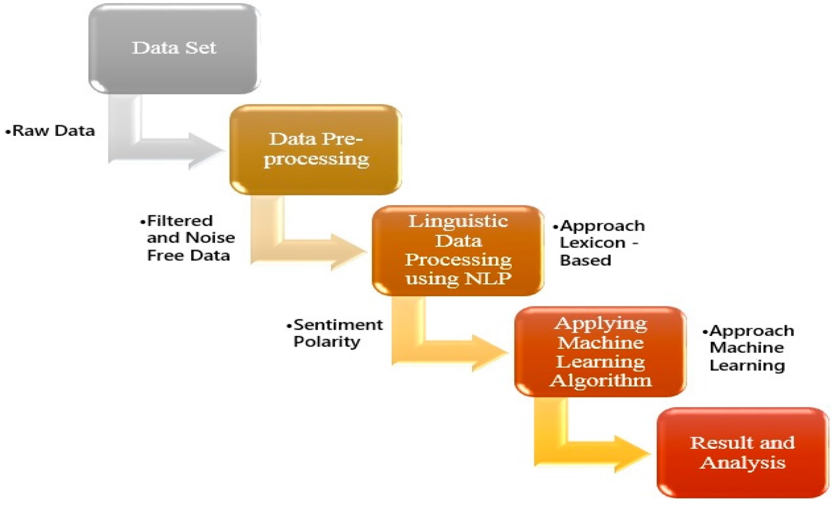
Department of CSE

Slide 16
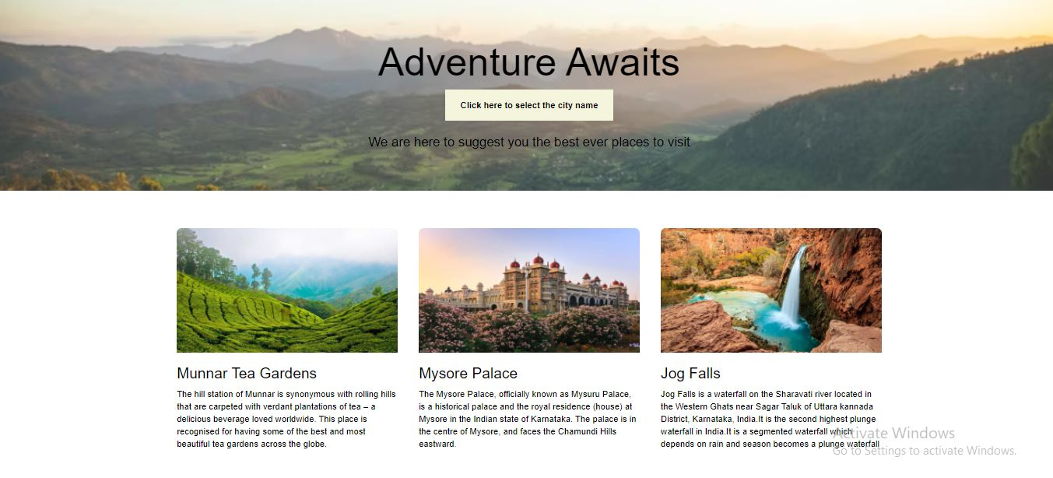
UI DESIGN
Department of CSE

Slide 17
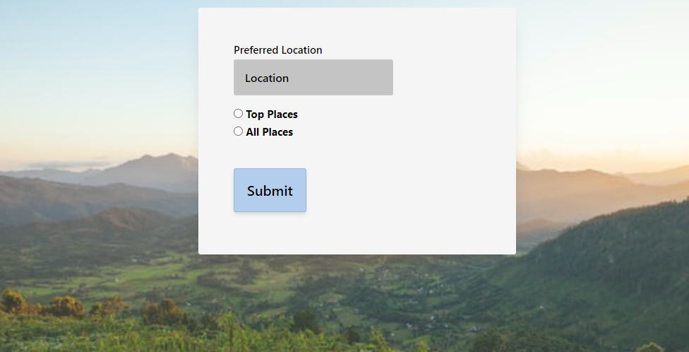
Department of CSE

Slide 18
REQUIREMENTS
DEVELOPMENT REQUIREMENT
Python
Flask (Micro Framework)
Jupyter Notebook
HTML
CSS
Department of CSE

Slide 19
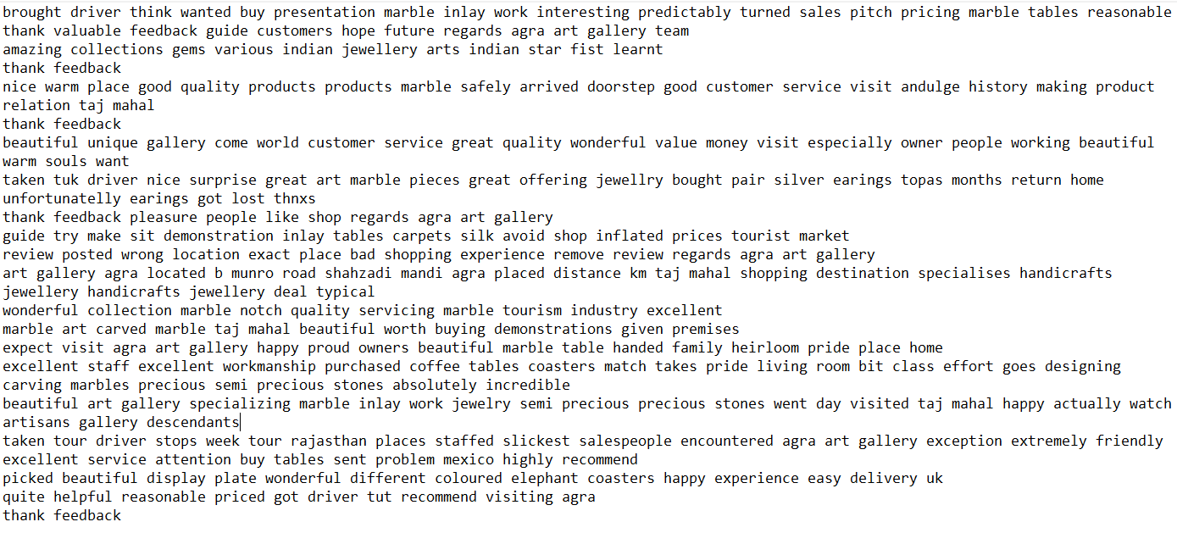
Output of Preprocessed Review
Department of CSE

Slide 20
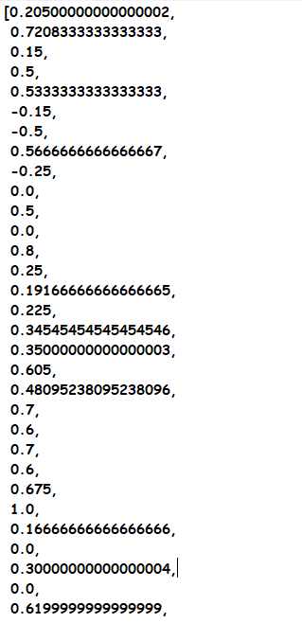
Output of sentimental analysis on Preprocessed Review
Department of CSE

Slide 21
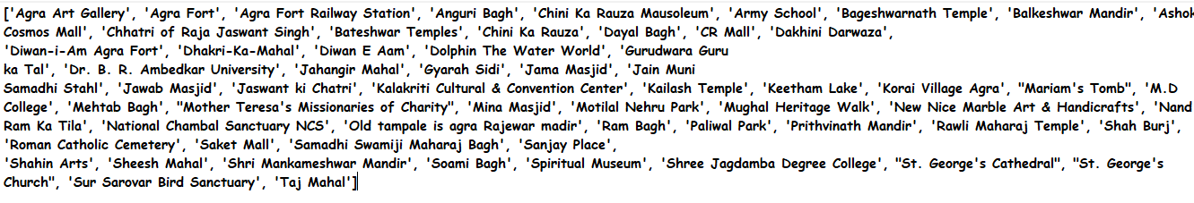
Output of content-based filtering over the place Agra
Department of CSE

Slide 22
Home Page
Department of CSE

Slide 23
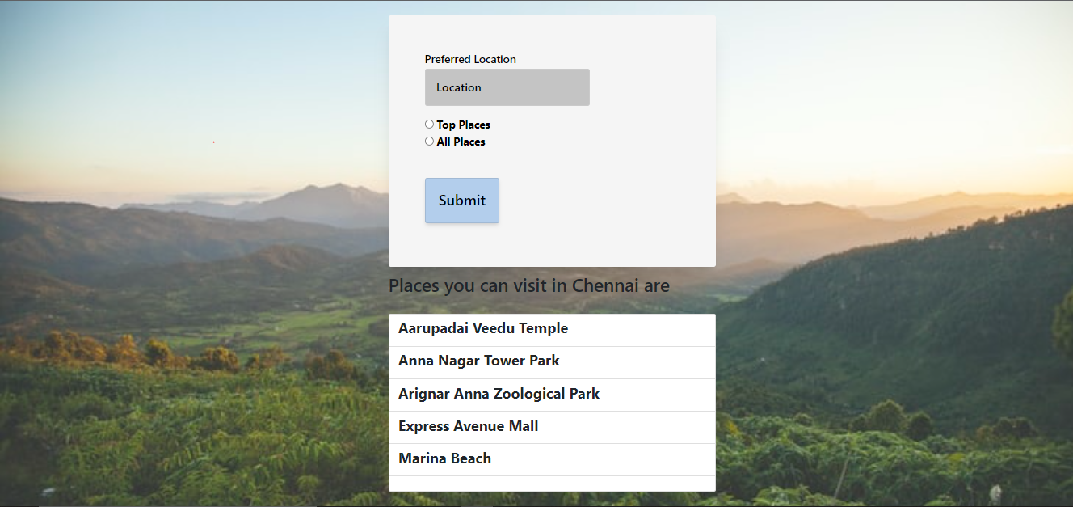
City=Chennai
TOP PLACES
Department of CSE

Slide 24
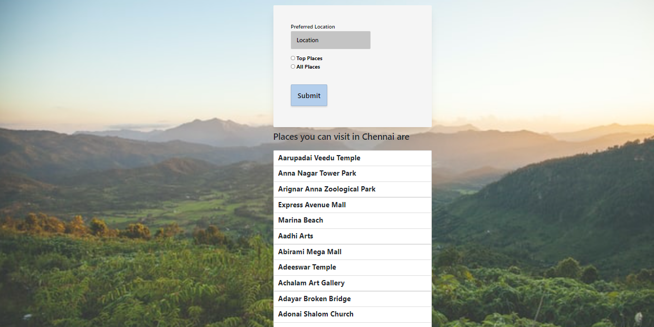
City=Chennai
ALL PLACES
Department of CSE

Slide 25
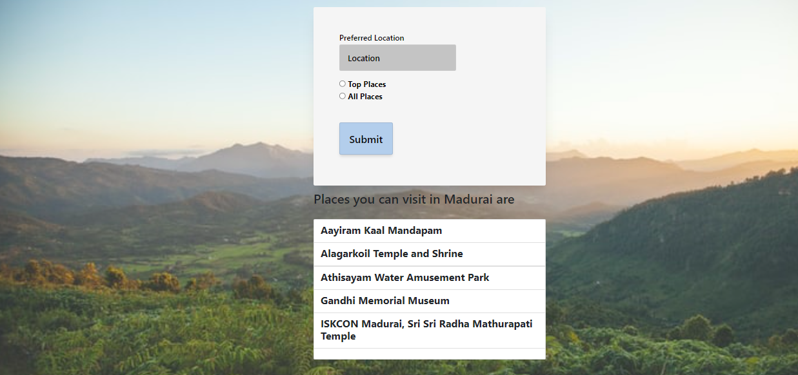
City=Madurai
TOP PLACES
Department of CSE

Slide 26
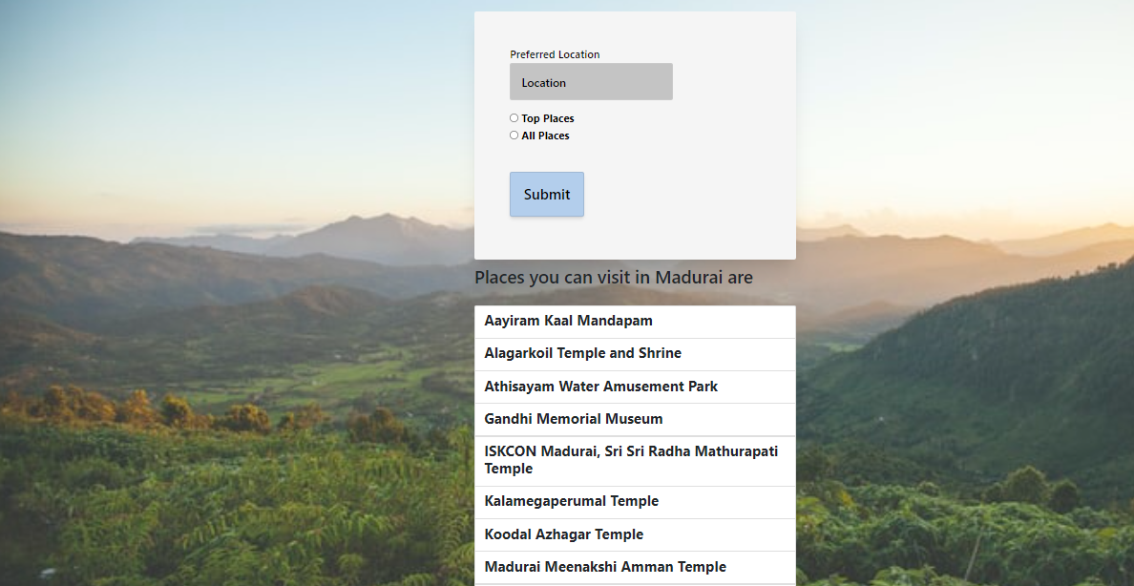
City=Madurai
ALL PLACES
Department of CSE

Slide 27
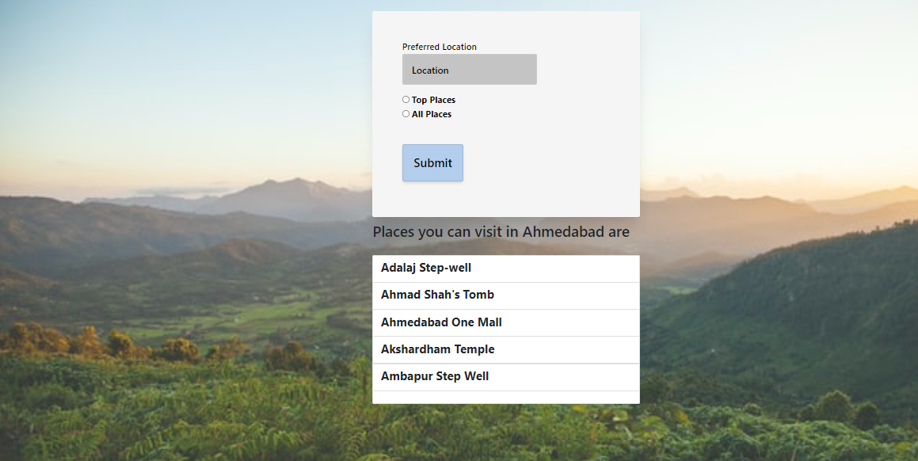
City=Ahmedabad
TOP PLACES
Department of CSE

Slide 28
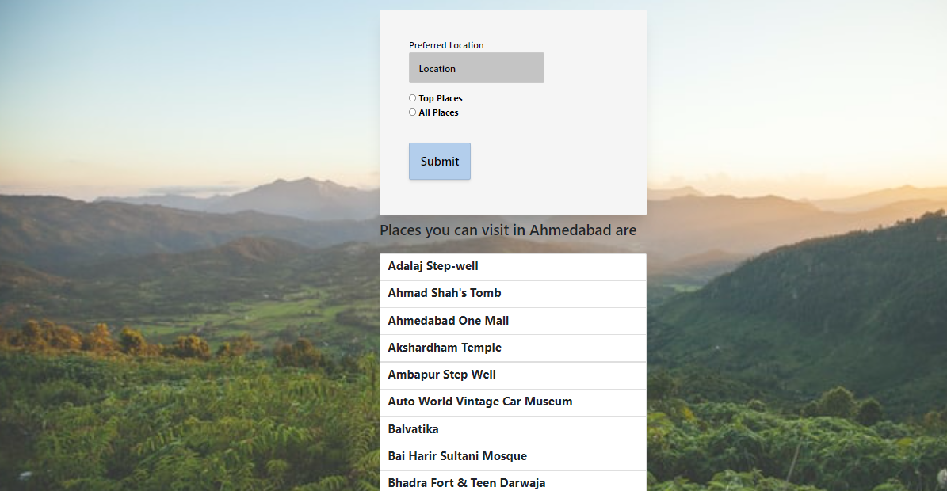
City=Ahmedabad
ALL PLACES
Department of CSE

Slide 29
CONCLUSION
This system enhances
Optimum utilisation of resources
Efficient management of records
Portable and flexible
User friendly
Simplification of operations
Department of CSE

Slide 30
FUTURE ENHANCEMENT
Trying different machine learning techniques to improve efficiency.
To develop a neural network model based on the machine learning techniques to improve accuracy.
To host the platform on online servers to make it accessible worldwide.
Department of CSE

Slide 31
https://www.hindawi.com/journals/cin/2016/1291358/
REFERENCES
https://www.hindawi.com/journals/cin/2016/1291358/
https://www.spec-india.com/blog/ml-based-hybrid-recommendation-system
Department of CSE

Slide 32
THANK YOU
Department of CSE

